Slide 1
CH2 排序 (sort)

Slide 2

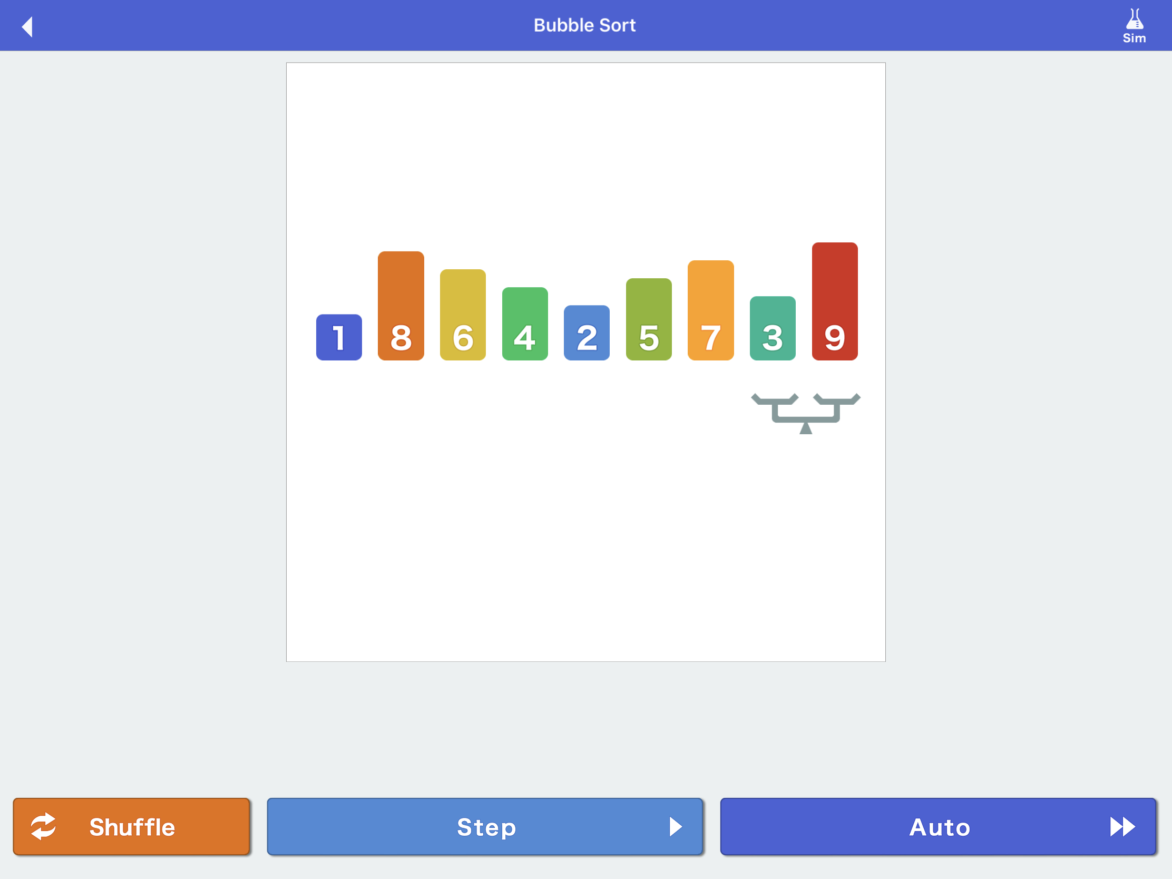
Algorithms (iOS Apps 動畫演示)
Bubble Sort (實作)
Selection Sort (實作)
Insertion Sort (實作)
Merge Sort (CH6)
Quick Sort (CH6)
公認最佳排序法
Python method or BIF
list.sort() in-place operation
sorted(list) return value

Slide 3
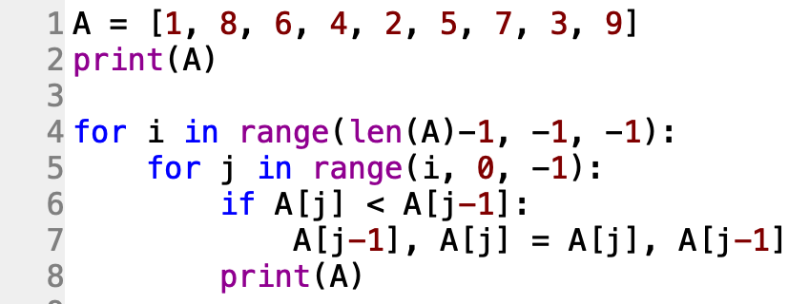
Bubble sort
﻿[1, 8, 6, 4, 2, 5, 7, 3, 9]
[1, 8, 6, 4, 2, 5, 7, 3, 9]
[1, 8, 6, 4, 2, 5, 3, 7, 9]
[1, 8, 6, 4, 2, 3, 5, 7, 9]
[1, 8, 6, 4, 2, 3, 5, 7, 9]
[1, 8, 6, 2, 4, 3, 5, 7, 9]
[1, 8, 2, 6, 4, 3, 5, 7, 9]
[1, 2, 8, 6, 4, 3, 5, 7, 9]
[1, 2, 8, 6, 4, 3, 5, 7, 9]
[1, 2, 8, 6, 4, 3, 5, 7, 9]
[1, 2, 8, 6, 4, 3, 5, 7, 9]
[1, 2, 8, 6, 3, 4, 5, 7, 9]
[1, 2, 8, 3, 6, 4, 5, 7, 9]
[1, 2, 3, 8, 6, 4, 5, 7, 9]
[1, 2, 3, 8, 6, 4, 5, 7, 9]
[1, 2, 3, 8, 6, 4, 5, 7, 9]
[1, 2, 3, 8, 6, 4, 5, 7, 9]
[1, 2, 3, 8, 4, 6, 5, 7, 9]
[1, 2, 3, 4, 8, 6, 5, 7, 9]
[1, 2, 3, 4, 8, 6, 5, 7, 9]
[1, 2, 3, 4, 8, 6, 5, 7, 9]
[1, 2, 3, 4, 8, 6, 5, 7, 9]
[1, 2, 3, 4, 6, 8, 5, 7, 9]
[1, 2, 3, 4, 6, 8, 5, 7, 9]
[1, 2, 3, 4, 6, 8, 5, 7, 9]
[1, 2, 3, 4, 6, 8, 5, 7, 9]
[1, 2, 3, 4, 6, 8, 5, 7, 9]
[1, 2, 3, 4, 6, 8, 5, 7, 9]
[1, 2, 3, 4, 6, 8, 5, 7, 9]
[1, 2, 3, 4, 6, 8, 5, 7, 9]
[1, 2, 3, 4, 6, 8, 5, 7, 9]
[1, 2, 3, 4, 6, 8, 5, 7, 9]
[1, 2, 3, 4, 6, 8, 5, 7, 9]
[1, 2, 3, 4, 6, 8, 5, 7, 9]
[1, 2, 3, 4, 6, 8, 5, 7, 9]
[1, 2, 3, 4, 6, 8, 5, 7, 9]
[1, 2, 3, 4, 6, 8, 5, 7, 9]
Time complexity: O(n²)

Slide 4
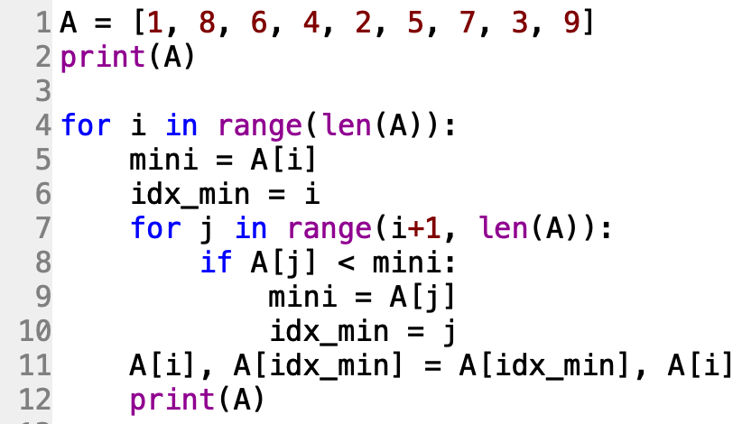
Selection Sort
Time complexity: O(n²)
﻿[1, 8, 6, 4, 2, 5, 7, 3, 9]
[1, 8, 6, 4, 2, 5, 7, 3, 9]
[1, 2, 6, 4, 8, 5, 7, 3, 9]
[1, 2, 3, 4, 8, 5, 7, 6, 9]
[1, 2, 3, 4, 8, 5, 7, 6, 9]
[1, 2, 3, 4, 5, 8, 7, 6, 9]
[1, 2, 3, 4, 5, 6, 7, 8, 9]
[1, 2, 3, 4, 5, 6, 7, 8, 9]
[1, 2, 3, 4, 5, 6, 7, 8, 9]
[1, 2, 3, 4, 5, 6, 7, 8, 9]

Slide 5
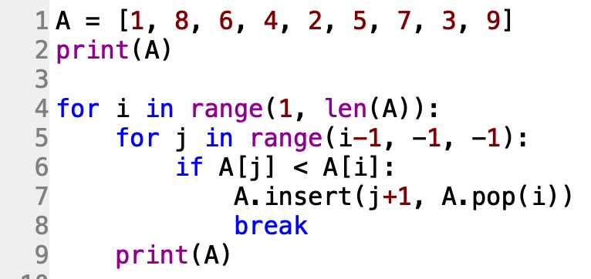
Insertion Sort
Time complexity: O(n²)
﻿[1, 8, 6, 4, 2, 5, 7, 3, 9]
[1, 8, 6, 4, 2, 5, 7, 3, 9]
[1, 6, 8, 4, 2, 5, 7, 3, 9]
[1, 4, 6, 8, 2, 5, 7, 3, 9]
[1, 2, 4, 6, 8, 5, 7, 3, 9]
[1, 2, 4, 5, 6, 8, 7, 3, 9]
[1, 2, 4, 5, 6, 7, 8, 3, 9]
[1, 2, 3, 4, 5, 6, 7, 8, 9]
[1, 2, 3, 4, 5, 6, 7, 8, 9]

Slide 6
Merge Sort & Quick Sort
參考: CH6 分治法 Divide & Conquer

Slide 7
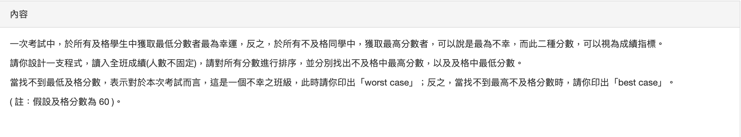
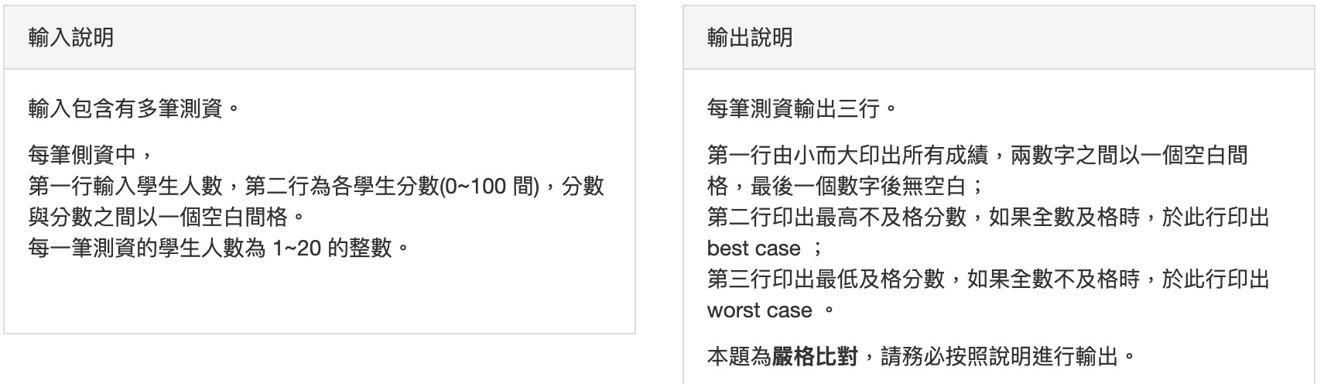
10503 第 1 題 成績指標
https://zerojudge.tw/ShowProblem?problemid=b964

Slide 8
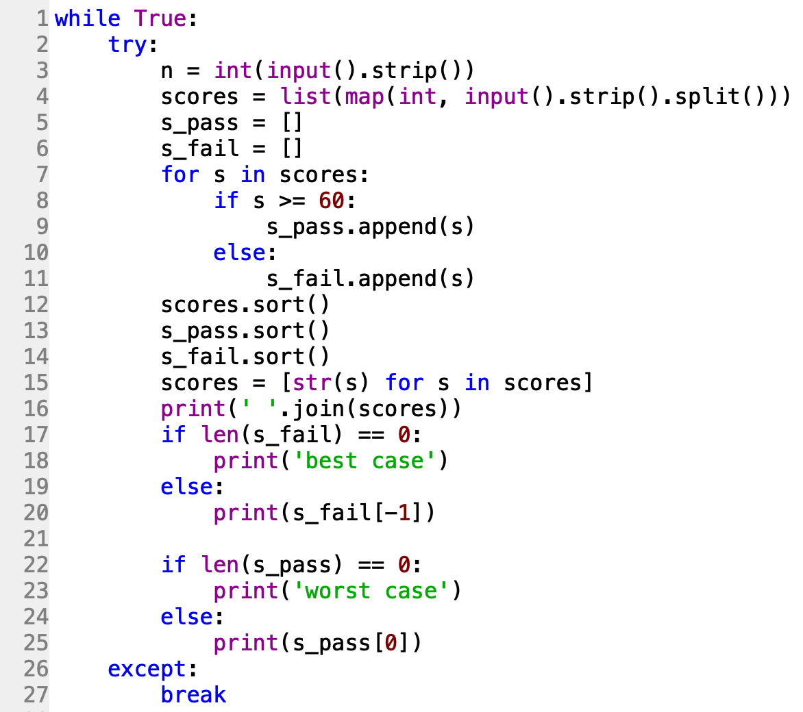
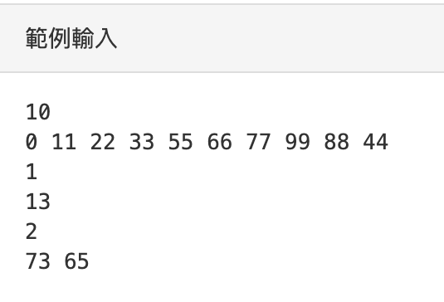
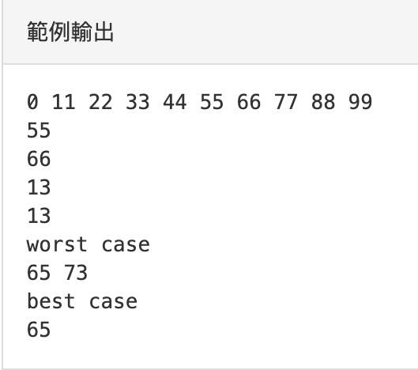

Slide 9
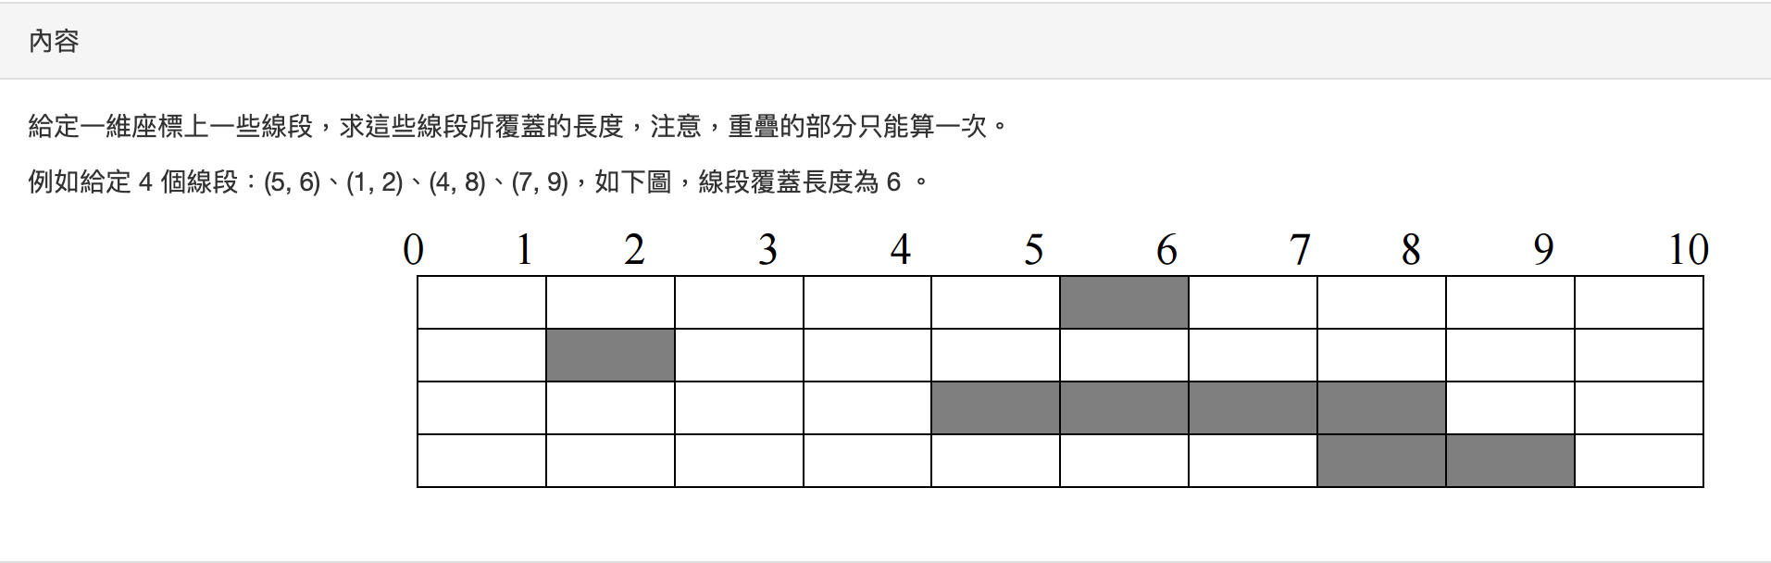
10503 第 3 題 線段覆蓋長度
https://zerojudge.tw/ShowProblem?problemid=b966

Slide 10
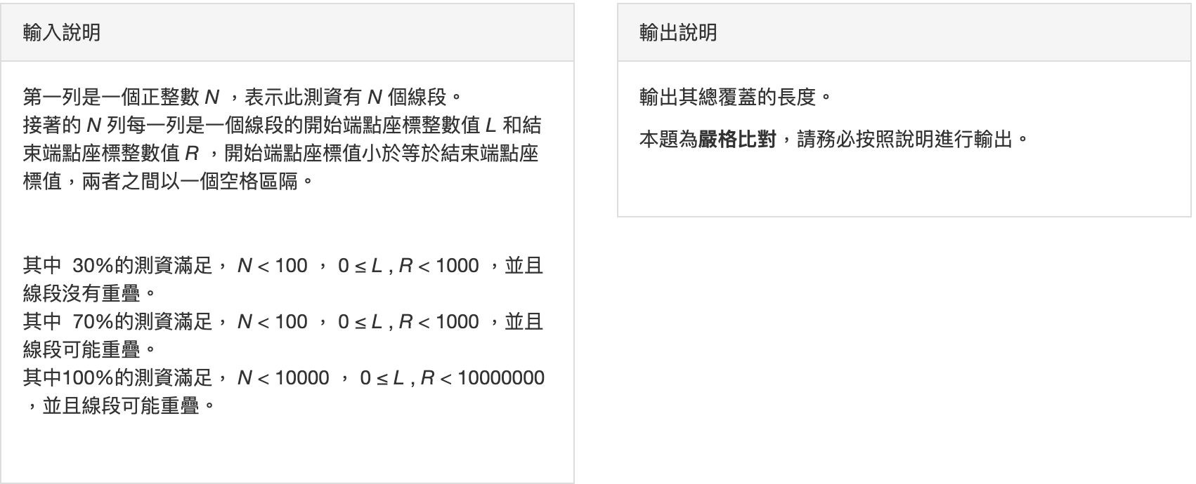

Slide 11
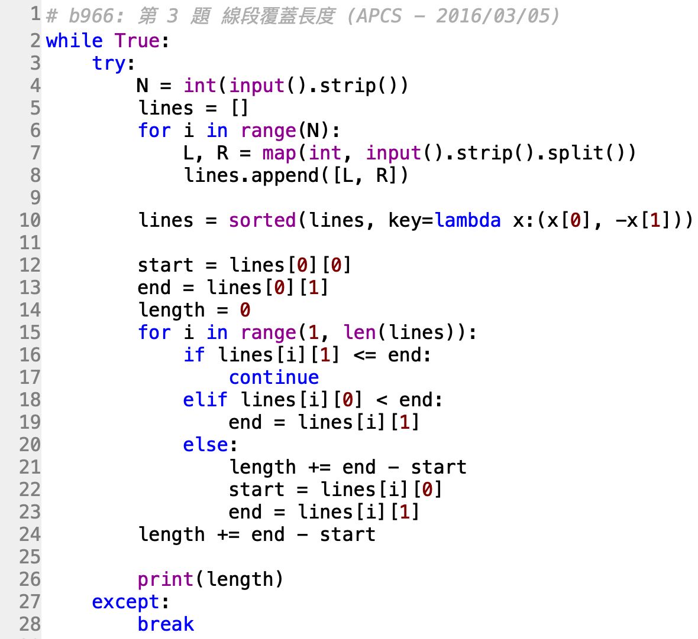
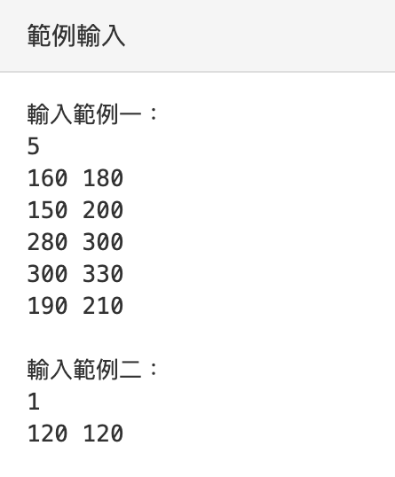
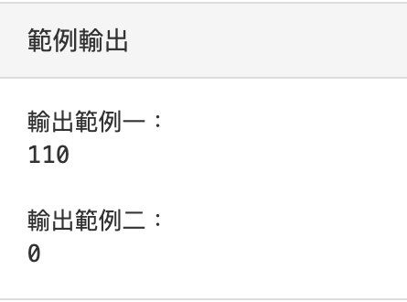

Slide 12
Exercise: UVa Online Judge
10107 - What is the Median?
https://zerojudge.tw/ShowProblem?problemid=c010
11462 - Age Sort
https://zerojudge.tw/ShowProblem?problemid=d190
11369 – Shopaholic
https://zerojudge.tw/ShowProblem?problemid=d150
10062 - Tell me the frequencies!
https://zerojudge.tw/ShowProblem?problemid=c012
10008 - What's Cryptanalysis
https://zerojudge.tw/ShowProblem?problemid=c044

Slide 13
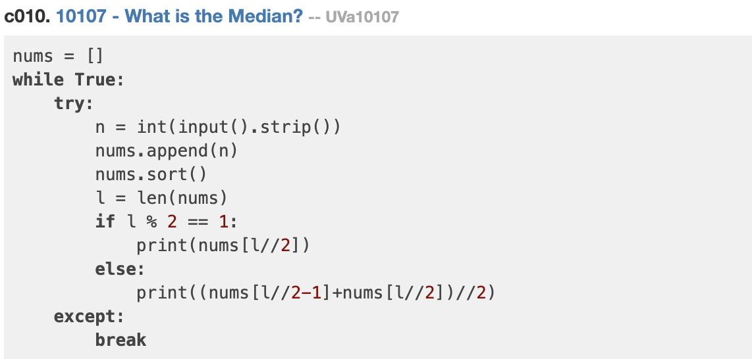

Slide 14
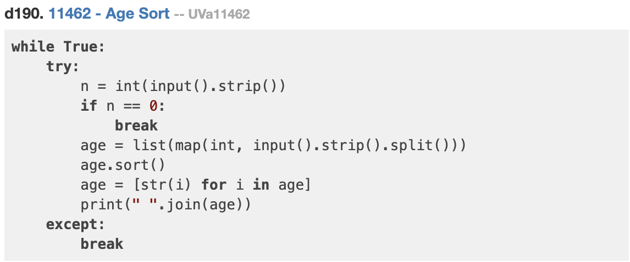

Slide 15
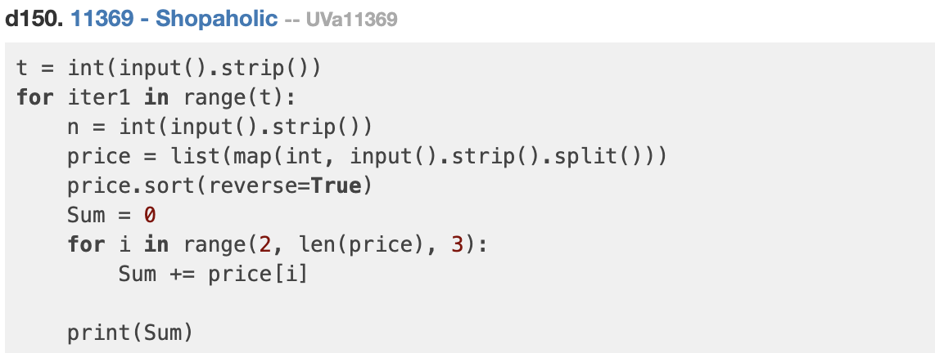

Slide 16
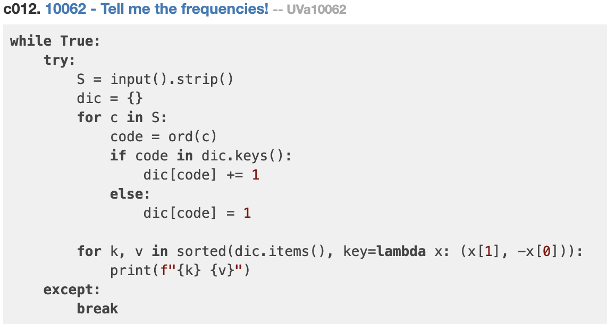

Slide 17
